Slide 1


PURR: A Primitive for Reconfigurable Fast Reroute
Marco Chiesa KTH Royal Institute of Technology Code: bitbucket.org/marchiesa/purr
Joint work with: Roshan Sedar Gianni Antichi Michael Borokhovich Andrzej Kamisiński Georgios Nikolaidis Stefan Schmid

Slide 2


PURR: Thanks to my coauthors!
Joint work with: Roshan Sedar Gianni Antichi Michael Borokhovich Andrzej Kamisiński Georgios Nikolaidis Stefan Schmid

Slide 3

Network resilience is a key yet challenging property
High resilience
Why is it that hard?
Image credits: route by Philipp Petzka from the Noun Project

Slide 4

Routing reconvergence takes time!
routing restoration
failure event
control-plane detection & route recomputation
time
data-plane update
Video shot taken from “Lemmings” designed and developed by DMA Design

Slide 5

Centralized controllers make reconvergence slower
failure occurs
control-plane detection & route recomputation
time
Advanced SDN routing e.g., intent-based logically centralized SDN
High resilience
data-plane update
Image credits: route by Philipp Petzka from the Noun Project

Slide 6
Hard to recover within 50ms!
failure occurs
control-plane detection & route recomputation
time
Advanced SDN routing e.g., intent-based logically centralized SDN
High resilience
“[carrier-grade networks] level of availability requires substantial over-provisioning and fast reroute local recovery, e.g., within 50 milliseconds“ [1]
data-plane update
[1] On low-latency-capable topologies, and their impact on the design of intra-domain routing. In SIGCOMM 2018
Image credits: route by Philipp Petzka from the Noun Project

Slide 7



Fast Reroute (FRR): pre-computing failover paths
match/actions (e.g., at X)
1
dst = A >> FRR₁
C
2nd backup
FRR actions (e.g., at X)
X
B
primary
backup
B
C
FRR₁ >> fwd A
control plane
A
FRR entails solving two orthogonal problems:
control-plane: compute network-wide primary/backup forwarding rules

Slide 8
Fast Reroute (FRR): pre-computing failover paths
match/actions (e.g., at X)
1
dst = A >> FRR₁
C
dst = B >> FRR₂
backup
FRR actions (e.g., at X)
X
B
primary
B
C
FRR₁ >> fwd A
2nd backup
control plane
FRR₂ >> fwd B C A
A
FRR entails solving two orthogonal problems:
control-plane: compute network-wide primary/backup forwarding rules

Slide 9
Fast Reroute (FRR): pre-computing failover paths
header/metadata
parser
deparser
match/actions (e.g., at X)
1
2
C
dst = A >> FRR₁
dst = A >> FRR₁
packet pipeline
dst = B >> FRR₂
dst = B >> FRR₂
backup
FRR actions (e.g., at X)
X
B
primary
FRR₁ >> fwd A B C
control plane
FRR₁ >> fwd A B C
2nd backup
FRR₂ >> fwd C B A
FRR₂ >> fwd C B A
A
FRR entails solving two orthogonal problems:
control-plane: compute network-wide primary/backup forwarding rules
data-plane: support conditional forwarding in each switch

Slide 10

The goal of this talk: implement a FRR primitive that minimizes pipeline resource consumption
header/metadata
parser
dst = A >> FRR₁ dst = B >> FRR₂
FRR₁ >> fwd A B C FRR₂ >> fwd C B A
deparser
2
PURR: A building block for implementing arbitrary FRR mechanisms
packet pipeline
Input
Output
FRR actions (e.g., at X)
FRR₁ >> fwd A B C
FRR₂ >> fwd C B A
Cat by dDara from the Noun Project

Slide 11
PURR applies to P4 programmable switches
Packet recirculation
simplified pipeline
Packets in
Parser
Packets out
stage 1
stage N
ingress buffer
stage …
Input headers & metadata
High availability
(e.g., within 50 milliseconds”[1])
Advanced SDN routing (e.g., intent-based logically centralized SDN)
High flexibility
(e.g., reconfigurable P4 dataplanes)
Resources:
- SRAM (exact matches), e.g., 2M entries
- TCAM (wildcard matches), e.g., 100K entries
- ALU
Runtime P4 (Control plane)
[1] On low-latency-capable topologies, and their impact on the design of intra-domain routing. In SIGCOMM 2018
Image credits: route by Philipp Petzka from the Noun Project

Slide 12
PURR applies to P4 programmable switches
Packet recirculation
simplified pipeline
Packets in
Parser
Packets out
stage 1
stage N
ingress buffer
stage …
Input headers & metadata
High availability
(e.g., within 50 milliseconds”[1])
Advanced SDN routing (e.g., intent-based logically centralized SDN)
High flexibility
(e.g., reconfigurable P4 dataplanes)
Resources:
- SRAM (exact matches), e.g., 2M entries
- TCAM (wildcard matches), e.g., 100K entries
- ALU
How do we realize FRR in P4?
No P4 built-in FRR primitive but… a programmable pipeline: many approaches are possible!
Runtime P4 (Control plane)
[1] On low-latency-capable topologies, and their impact on the design of intra-domain routing. In SIGCOMM 2018
Image credits: route by Philipp Petzka from the Noun Project

Slide 13

First approach: packet recirculation
match tag | action
 | fwd | write & recirculate
1 | 1 | tag := 2
2 | 2 | tag := 3
3 | 3 | tag := 4
4 | 4 | -
Input
port 1 fails
FRR₁ = 1 2 3 4
port 2 fails
throughput reduction
latency increase

Slide 14
FRR recirculation has high memory occupancy
match tag | action
 | fwd | write & recirculate
1 | 1 | tag := 2
2 | 2 | tag := 3
3 | 3 | tag := 4
4 | 4 | -
5 | 4 | tag:= 6
6 | 3 | tag = 7
7 | 2 | tag = 8
8 | 1 | -
Input
FRR₁ = 1 2 3 4
FRR₂ = 4 3 2 1
throughput reduction
latency increase
port 4 fails
throughput reduction
latency increase
high memory overhead
port 3 fails

Slide 15



PURR: a primitive for reconfigurable FRR
A building block for implementing arbitrary FRR mechanisms
high throughput | low forwarding latency | efficient reroute | flexibility | small forwarding tables
parallel search with TCAM
model port status -> flip one single bit
support arbitrary FRR mechanisms, i.e., arbitrary FRR input sequences
Cat by dDara from the Noun Project

Slide 16
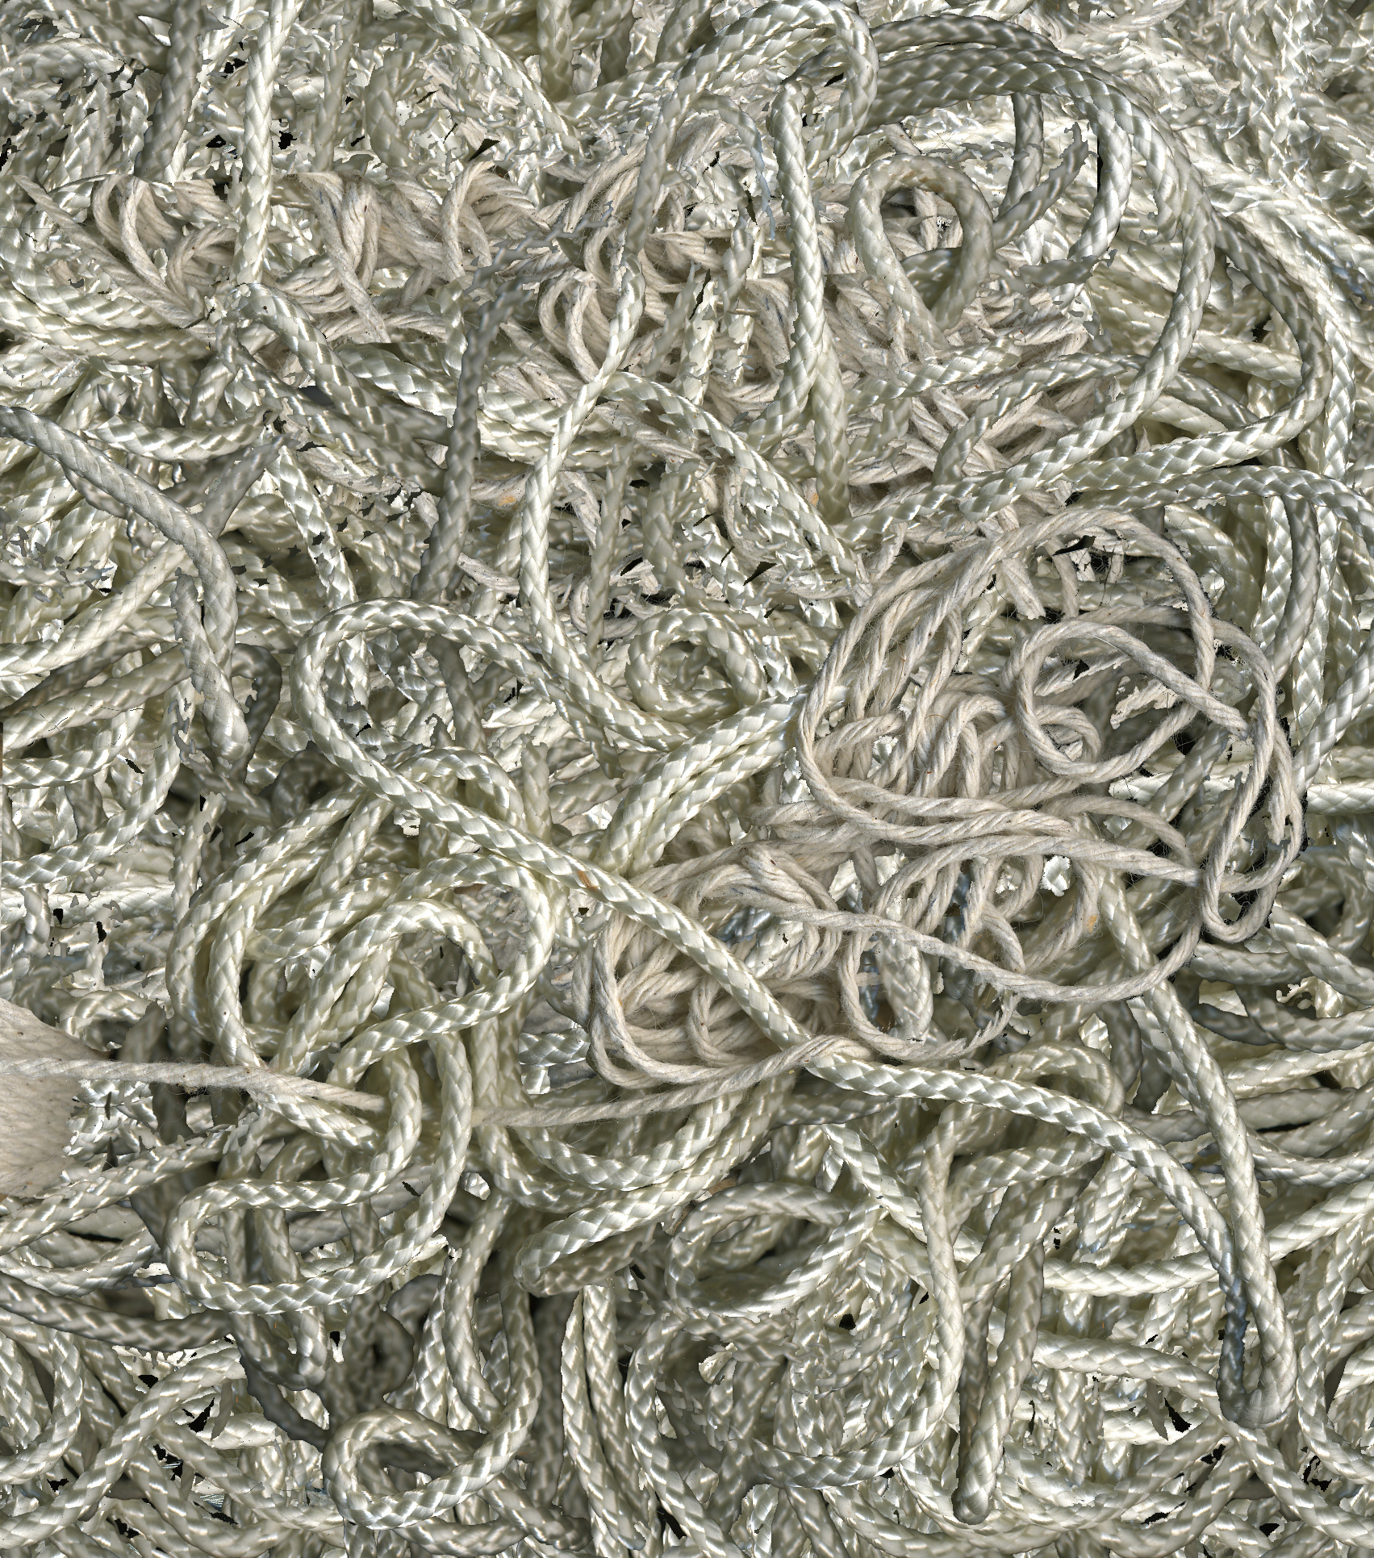
PURR: a primitive for reconfigurable FRR
A building block for implementing arbitrary FRR mechanisms
intriguing connection to (algorithmic) “string theory”
high throughput | low forwarding latency | efficient reroute | flexibility | small forwarding tables
Cat by dDara from the Noun Project

Slide 17
PURR: Encoding FRR in the packet metadata
Input
FRR₁ = 1 2 3 4
packet metadata
FRR = 1
match | action
port status | fwd
1 * * * | 1
* 1 * * | 2
* * 1 * | 3
* * * 1 | 4
port 1 is active
port 2 is active
port status
1 1 1 1
port status
1 1 1 1
P4 register
TCAM wildcard match memory

Slide 18
PURR: Encoding FRR in the packet metadata
Input
FRR₁ = 1 2 3 4
packet metadata
FRR = 1
port status
1 1 1 1
match | action
port status | fwd
1 * * * | 1
* 1 * * | 2
* * 1 * | 3
* * * 1 | 4
TCAM wildcard match memory

Slide 19
PURR: Encoding FRR in the packet metadata
Input
FRR₁ = 1 2 3 4
packet metadata
FRR = 1
port status
0 1 1 1
match | action
port status | fwd
1 * * * | 1
* 1 * * | 2
* * 1 * | 3
* * * 1 | 4
port 1 fails
TCAM wildcard match memory

Slide 20
PURR: Encoding FRR in the packet metadata
Input
FRR₁ = 1 2 3 4
packet metadata
FRR = 1
port status
0 0 1 1
match | action
port status | fwd
1 * * * | 1
* 1 * * | 2
* * 1 * | 3
* * * 1 | 4
port 2 fails
TCAM wildcard match memory

Slide 21
PURR: One tempting option: “Duplication” TCAM
Input
FRR₁ = 1 2 3 4 FRR₂ = 2 3 4 1
packet metadata
FRR = 2
port status
0 0 1 1
match |  | action
FRR | port status | fwd
1 | 1 * * * | 1
1 | * 1 * * | 2
1 | * * 1 * | 3
1 | * * * 1 | 4
2 | * 1 * * | 2
2 | * * 1 * | 3
2 | * * * 1 | 4
2 | 1 * * * | 1
similar to FRR recirculation:
high memory overhead

Slide 22
PURR: Encoding FRR in the packet metadata
Input
FRR₁ = 1 2 3 4 FRR₂ = 2 3 4 1
packet metadata
FRR = 1
port status
1 1 1 1
Encoding FRR input:
add a packet metadata field frr_ports
map bits to the switch ports
set bit to 1 to include a port
set bit to 0 to skip a port
match | action write
 | frr_ports
FRR = 1 | 1 1 1 1 0
FRR = 2 | 0 1 1 1 1
match | action write
 | frr_ports
FRR = 1 | b₁b₂b₃b₄b₅
FRR = 2 | 0 1 1 1 1 0 0
FRR = 3 | 0 0 1 1 1 1 0
FRR = 4 | 0 0 0 1 1 1 1
bit-to-port mapping
1 2 3 4 1

Slide 23
PURR: Encoding FRR in the packet metadata
Input
FRR₁ = 1 2 3 4 FRR₂ = 2 3 4 1
packet metadata
FRR = 1
port status
1 1 1 1
match |  | action
frr_ports | port status | fwd
1 * * * * | 1 * * * | 1
* 1 * * * | * 1 * * | 2
* * 1 * * | * * 1 * | 3
* * * 1 * | * * * 1 | 4
* * * * 1 | 1 * * * | 1
match | action write
 | frr_ports
FRR = 1 | 1 1 1 1 0
FRR = 2 | 0 1 1 1 1
bit-to-port mapping
1 2 3 4 1

Slide 24
PURR: Encoding FRR in the packet metadata
Input
FRR₁ = 1 2 3 4 FRR₂ = 2 3 4 1
packet metadata
FRR = 1
port status
1 1 1 1
match |  | action
frr_ports | port status | fwd
1 * * * * | 1 * * * | 1
* 1 * * * | * 1 * * | 2
* * 1 * * | * * 1 * | 3
* * * 1 * | * * * 1 | 4
* * * * 1 | 1 * * * | 1
match | action write
 | frr_ports
FRR = 1 | 1 1 1 1 0
FRR = 2 | 0 1 1 1 1
bit-to-port mapping
1 2 3 4 1

Slide 25
PURR: Encoding FRR in the packet metadata
Input
FRR₁ = 1 2 3 4 FRR₂ = 2 3 4 1
packet metadata
FRR = 1
port status
0 1 1 1
match |  | action
frr_ports | port status | fwd
1 * * * * | 1 * * * | 1
* 1 * * * | * 1 * * | 2
* * 1 * * | * * 1 * | 3
* * * 1 * | * * * 1 | 4
* * * * 1 | 1 * * * | 1
match | action write
 | frr_ports
FRR = 1 | 1 1 1 1 0
FRR = 2 | 0 1 1 1 1
bit-to-port mapping
1 2 3 4 1

Slide 26
PURR: re-cycling TCAM entries
Input
FRR₁ = 1 2 3 4 FRR₂ = 2 3 4 1
packet metadata
FRR = 2
port status
1 1 1 1
match |  | action
frr_ports | port status | fwd
1 * * * * | 1 * * * | 1
* 1 * * * | * 1 * * | 2
* * 1 * * | * * 1 * | 3
* * * 1 * | * * * 1 | 4
* * * * 1 | 1 * * * | 1
match | action write
 | frr_ports
FRR = 1 | 1 1 1 1 0
FRR = 2 | 0 1 1 1 1
bit-to-port mapping
1 2 3 4 1

Slide 27
The key problem: How to compute the bit-to-port mapping that minimizes memory occupancy?
FRR₁ = 2 3 1 0 FRR₂ = 0 2 1 3 FRR₃ = 3 0 2 1 FRR₄ = 1 0 2 3
bit-to-port mapping = .2 3 1 0 2 1 3
FRR₁ = 2 3 1 0
FRR₂ = 0 2 1 3
FRR₃ = 3 0 2 1
FRR₄ = 1 0 2 3
bit-to-port mapping = ?
Shortest Common Supersequence (SCS) problem without repetitions
SCS without repetitions is computationally hard (based on [2])
Dynamic Programming (DPSCS) computes optimum in exponential time
[2 ]T. Jiang, M. Li. On the approximation of shortest common supersequences and longest common subsequences. In Journal on Computing.

Slide 28
Fast-Greedy: a heuristic for solving this specific SCS
F₁=3 1 0
F₂=0 1 3
F₃=3 0 1
F₄=3 1 2 0
remove 3
F₁=1 0
F₂=1 3
F₃=1
F₄=1 2 0
remove 1
F₁=2 3 1 0
F₂=2 0 1 3
F₃=2 3 0 1
F₄=3 1 2 0
remove 2
idea: remove the most frequent left-most element among the longest sequences
See the paper for:
multi-table optimization
F₁=1 0
F₂=0 1 3
F₃=0 1
F₄=1 2 0
remove 0
F₁=0
F₂=3
F₃= ---
F₄=2 0
remove 2
F₁=0
F₂=3
F₃= ---
F₄=0
remove 0
F₁= ---
F₂=3
F₃= ---
F₄= ---
remove 3
SCS =
3
0 1 2 0 3
2

Slide 29


Implementation feasibility
P4-based implementations:
implemented different FRR mechanisms in P4 using PURR (e.g., F10 [1], arborescences [2], BFS, DFS, rotor router [3])
compiled on Tofino
FPGA-based implementation:
implemented PURR on the NetFPGA-SUME platform
[1] V. Liu et al. "F10: A Fault-Tolerant Engineered Network" in NSDI 2013
[2] M. Chiesa et al. "On the Resiliency of Randomized Routing Against Multiple Edge Failures" in Transactions on Networking 2016
[3] Borokhovich et al ””Graph exploration algorithms” in HotSDN 2013

Slide 30
Evaluation: How does the FRR implementation impact memory and performance?
Two subquestions:
How much memory does PURR save?
How does performance in a datacenter vary depending on how one implements a FRR primitive?
See the paper for:
multi-table optimization
random vs tree-based FRR sequences
FPGA chip occupancy
low-size FRR sequences

Slide 31
How much memory does PURR save? The “circular sequences” case
Input:
switch with k ports
10 circular set of FRR sequences
“Duplication TCAM” FRR:
k² number of TCAM entries
With PURR encoding:
k-1 number of TCAM entries
10 Top-of-Rack switches in a datacenter with F10 FRR [nsdi-13]
10 destinations with the "k arc-disjoint" FRR mechanism [ton-16]
[nsdi-13] V. Liu et al. "F10: A Fault-Tolerant Engineered Network" in NSDI 2013
[ton-16] M. Chiesa et al. "On the Resiliency of Randomized Routing Against Multiple Edge Failures" in Transactions on Networking 2016

Slide 32
How much memory does PURR save? The “circular sequences” case
Input:
switch with k ports
10 circular set of FRR sequences
“Duplication TCAM” FRR:
k² number of TCAM entries
With PURR encoding:
k-1 number of TCAM entries
For k = 24
92% less TCAM entries
470 instead of 5.760
For k = 48
96% less TCAM entries
950 instead of 23.040
[nsdi-13] V. Liu et al. "F10: A Fault-Tolerant Engineered Network" in NSDI 2013
[ton-16] M. Chiesa et al. "On the Resiliency of Randomized Routing Against Multiple Edge Failures" in Transactions on Networking 2016

Slide 33
How much memory does PURR save? Fast-greedy performs close to the optimum
30
10⁶10⁵
10⁴
10³
10²
10¹
10⁰10⁻¹
20
Fast-greedy
DPSCS
avg. #TCAM entries
avg. time [ms]
10
DPSCS
Fast-greedy
0
2
3
4
5
6
7
8
2
3
4
5
6
7
number of FRR sequences
number of FRR sequences
Input: randomly generated set of FRR sequences of length 7

Slide 34
How much memory does PURR save? Fast-greedy scales to large number of sequences
32 factorial possible FRR sequences The “duplication” TCAM or recirculation FRR approaches would not scale
sequence size=32
sequence size=32
sequence size=16
sequence size=16
avg. #TCAM entries
sequence size=8
avg. TCAM bits
sequence size=8
Input: randomly generated set of FRR sequences

Slide 35
How does FCT vary depending on the FRR primitive? PURR improves both FCT and throughput
2.0
1.5
10¹
FRR recirculation
1.0
immediate reconvergence
Small flows FCT [ms]
2.4x
Throughput [Gbps]
2.7x
0.5
immediate reconvergence
10⁰
FRR recirculation
0.0
10
20
30
40
50
60
70
10
20
30
40
50
60
70
Load [%]
Load [%]
NS-3 simulations
Topology: 32-server Clos network, 10Gbps links
Workload: data-mining Transport: DCTCP One link failure at 0.5s

Slide 36
How does FCT vary depending on the FRR primitive? PURR improves both FCT and throughput
2.0
1.5
10¹
FRR recirculation
1.0
immediate reconvergence
Small flows FCT [ms]
purr
2x
Throughput [Gbps]
0.5
1.4x
purr
immediate reconvergence
10⁰
FRR recirculation
0.0
10
20
30
40
50
60
70
10
20
30
40
50
60
70
Load [%]
Load [%]
NS-3 simulations
Topology: 32-server Clos network, 10Gbps links
Workload: data-mining Transport: DCTCP One link failure at 0.5s

Slide 37

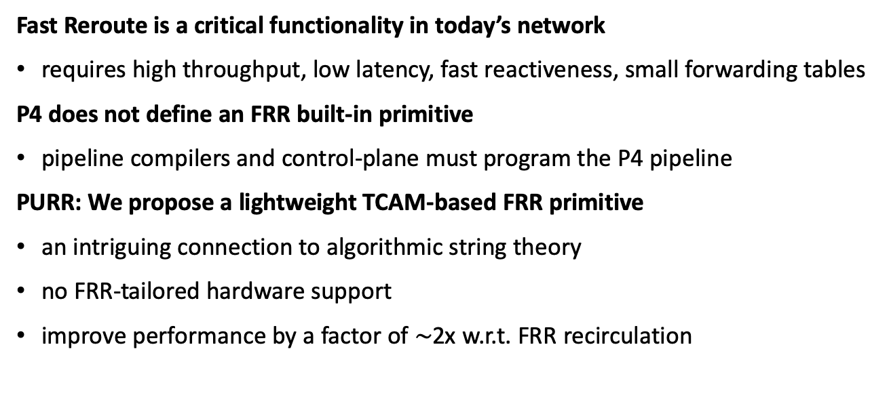
Conclusions: Keep calm and enjoy programmability
Fast Reroute is a critical functionality in today’s network
requires high throughput, low latency, fast reactiveness, small forwarding tables
P4 does not define an FRR built-in primitive
pipeline compilers and control-plane must program the P4 pipeline
PURR: We propose a lightweight TCAM-based FRR primitive
an intriguing connection to algorithmic string theory
no FRR-tailored hardware support
improve performance by a factor of $\sim$2x w.r.t. FRR recirculation
Marco Chiesa KTH Royal Institute of Technology Code: bitbucket.org/marchiesa/purr
Thank you!
reusable
Cat by dDara from the Noun Project

Slide 38
Backup slides

Slide 39
Smaller sequences on switches with high-density ports
Input:
a 64-port programmable switch
all possible three ports FRR sequences
“Duplication TCAM” approach:
#TCAM entries = 64*63*62*3 = 750K
TCAM memory = 750K * (20 + 3) = 17.2Mb
FRR recirculation:
#TCAM entries = 64*63*62 = 250K
TCAM memory = 250K * (17+3) = 5Mb
PURR encoding approach:
#TCAM entries < (64*3) = 192
TCAM memory < 192 * (64*4) = 50Kb
more than 99% memory reduction!

Slide 40
Three naïve approaches to implementing FRR
FRR recirculation
FRR sequential
FRR parallel duplication
throughput
low
high
high
latency
low
low
high
reactiveness
low
low
high
memory
high
high
high
flexibility
high
high
high

Slide 41
Second approach: sequential search
Input
FRR₁ = 1 2 3 4 FRR₂ = 2 3 4 1 FRR₃ = 3 4 1 2 FRR₄ = 4 1 2 3
match | action
FRR = 1 | fwd(1)
match | action
FRR = 1 | fwd(2)
match | action
FRR = 1 | fwd(3)
match | action
FRR = 1 | fwd(4)

Slide 42
Second approach: sequential search
Input
FRR₁ = 1 2 3 4 FRR₂ = 2 3 4 1 FRR₃ = 3 4 1 2 FRR₄ = 4 1 2 3
match | action
FRR = 1 | fwd(1)
FRR = 2 | fwd(2)
match | action
FRR = 1 | fwd(2)
FRR = 2 | fwd(3)
match | action
FRR = 1 | fwd(3)
FRR = 2 | fwd(4)
match | action
FRR = 1 | fwd(4)
FRR = 2 | fwd(1)

Slide 43
Second approach: sequential search
Input
FRR₁ = 1 2 3 4 FRR₂ = 2 3 4 1 FRR₃ = 3 4 1 2 FRR₄ = 4 1 2 3
match | action
FRR = 1 | fwd(1)
FRR = 2 | fwd(2)
FRR = 3 | fwd(3)
match | action
FRR = 1 | fwd(2)
FRR = 2 | fwd(3)
FRR = 3 | fwd(4)
match | action
FRR = 1 | fwd(3)
FRR = 2 | fwd(4)
FRR = 3 | fwd(1)
match | action
FRR = 1 | fwd(4)
FRR = 2 | fwd(1)
FRR = 3 | fwd(2)

Slide 44
Second approach: sequential search
Input
FRR₁ = 1 2 3 4 FRR₂ = 2 3 4 1 FRR₃ = 3 4 1 2 FRR₄ = 4 1 2 3
match | action
FRR = 1 | fwd(1)
FRR = 2 | fwd(2)
FRR = 3 | fwd(3)
FRR = 4 | fwd(4)
match | action
FRR = 1 | fwd(2)
FRR = 2 | fwd(3)
FRR = 3 | fwd(4)
FRR = 4 | fwd(1)
match | action
FRR = 1 | fwd(3)
FRR = 2 | fwd(4)
FRR = 3 | fwd(1)
FRR = 4 | fwd(2)
match | action
FRR = 1 | fwd(4)
FRR = 2 | fwd(1)
FRR = 3 | fwd(2)
FRR = 4 | fwd(3)

Slide 45
A sequential search wastes hardware resources
Input
FRR₁ = 1 2 3 4 FRR₂ = 2 3 4 1 FRR₃ = 3 4 1 2 FRR₄ = 4 1 2 3
match | action
FRR = 1 | fwd(1)
FRR = 2 | fwd(2)
FRR = 3 | fwd(3)
FRR = 4 | fwd(4)
match | action
FRR = 1 | fwd(2)
FRR = 2 | fwd(3)
FRR = 3 | fwd(4)
FRR = 4 | fwd(1)
match | action
FRR = 1 | fwd(3)
FRR = 2 | fwd(4)
FRR = 3 | fwd(1)
FRR = 4 | fwd(2)
match | action
FRR = 1 | fwd(4)
FRR = 2 | fwd(1)
FRR = 3 | fwd(2)
FRR = 4 | fwd(3)
increased latency
waste of resources at each stage
many updates to the forwarding table
port 2 fails
port 3 fails

Slide 46
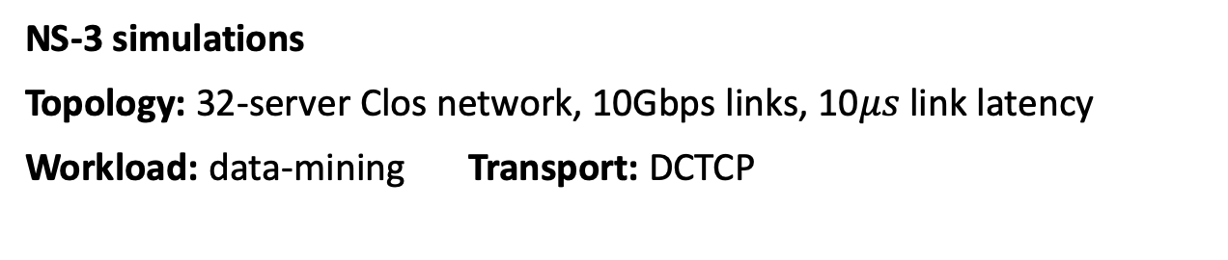
PURR improves both FCT and throughput Two link failures, higher gains
1.7x
1.8x
NS-3 simulations
Topology: 32-server Clos network, 10Gbps links, 10$μs$ link latency
Workload: data-mining Transport: DCTCP

Slide 47
Evaluation: Random vs tree-based sequences

Slide 48
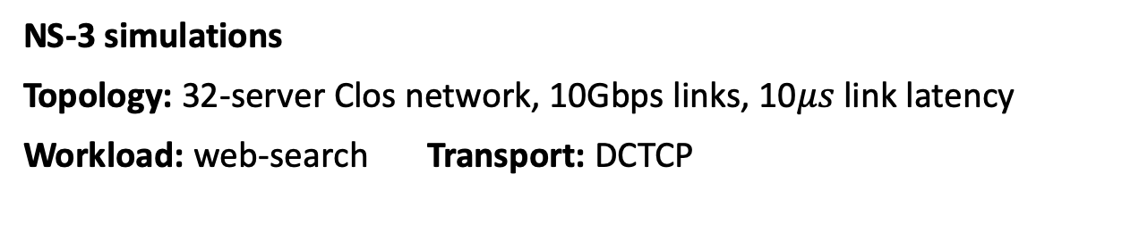
The web search workload
NS-3 simulations
Topology: 32-server Clos network, 10Gbps links, 10$μs$ link latency
Workload: web-search Transport: DCTCP

